Slide 1


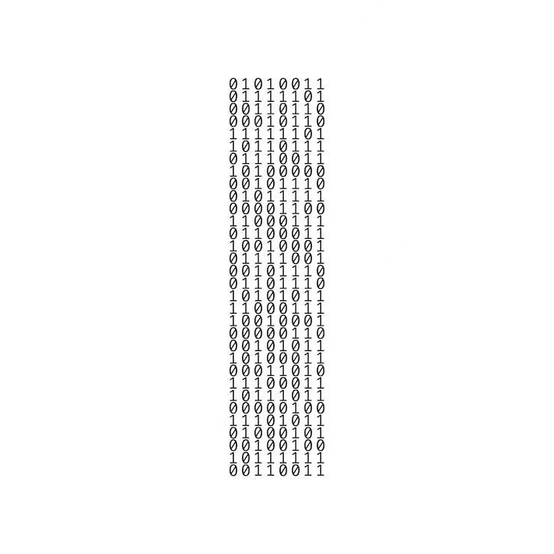
Mission impossible
BTD binary to decimal
Math game project 2023

Slide 2
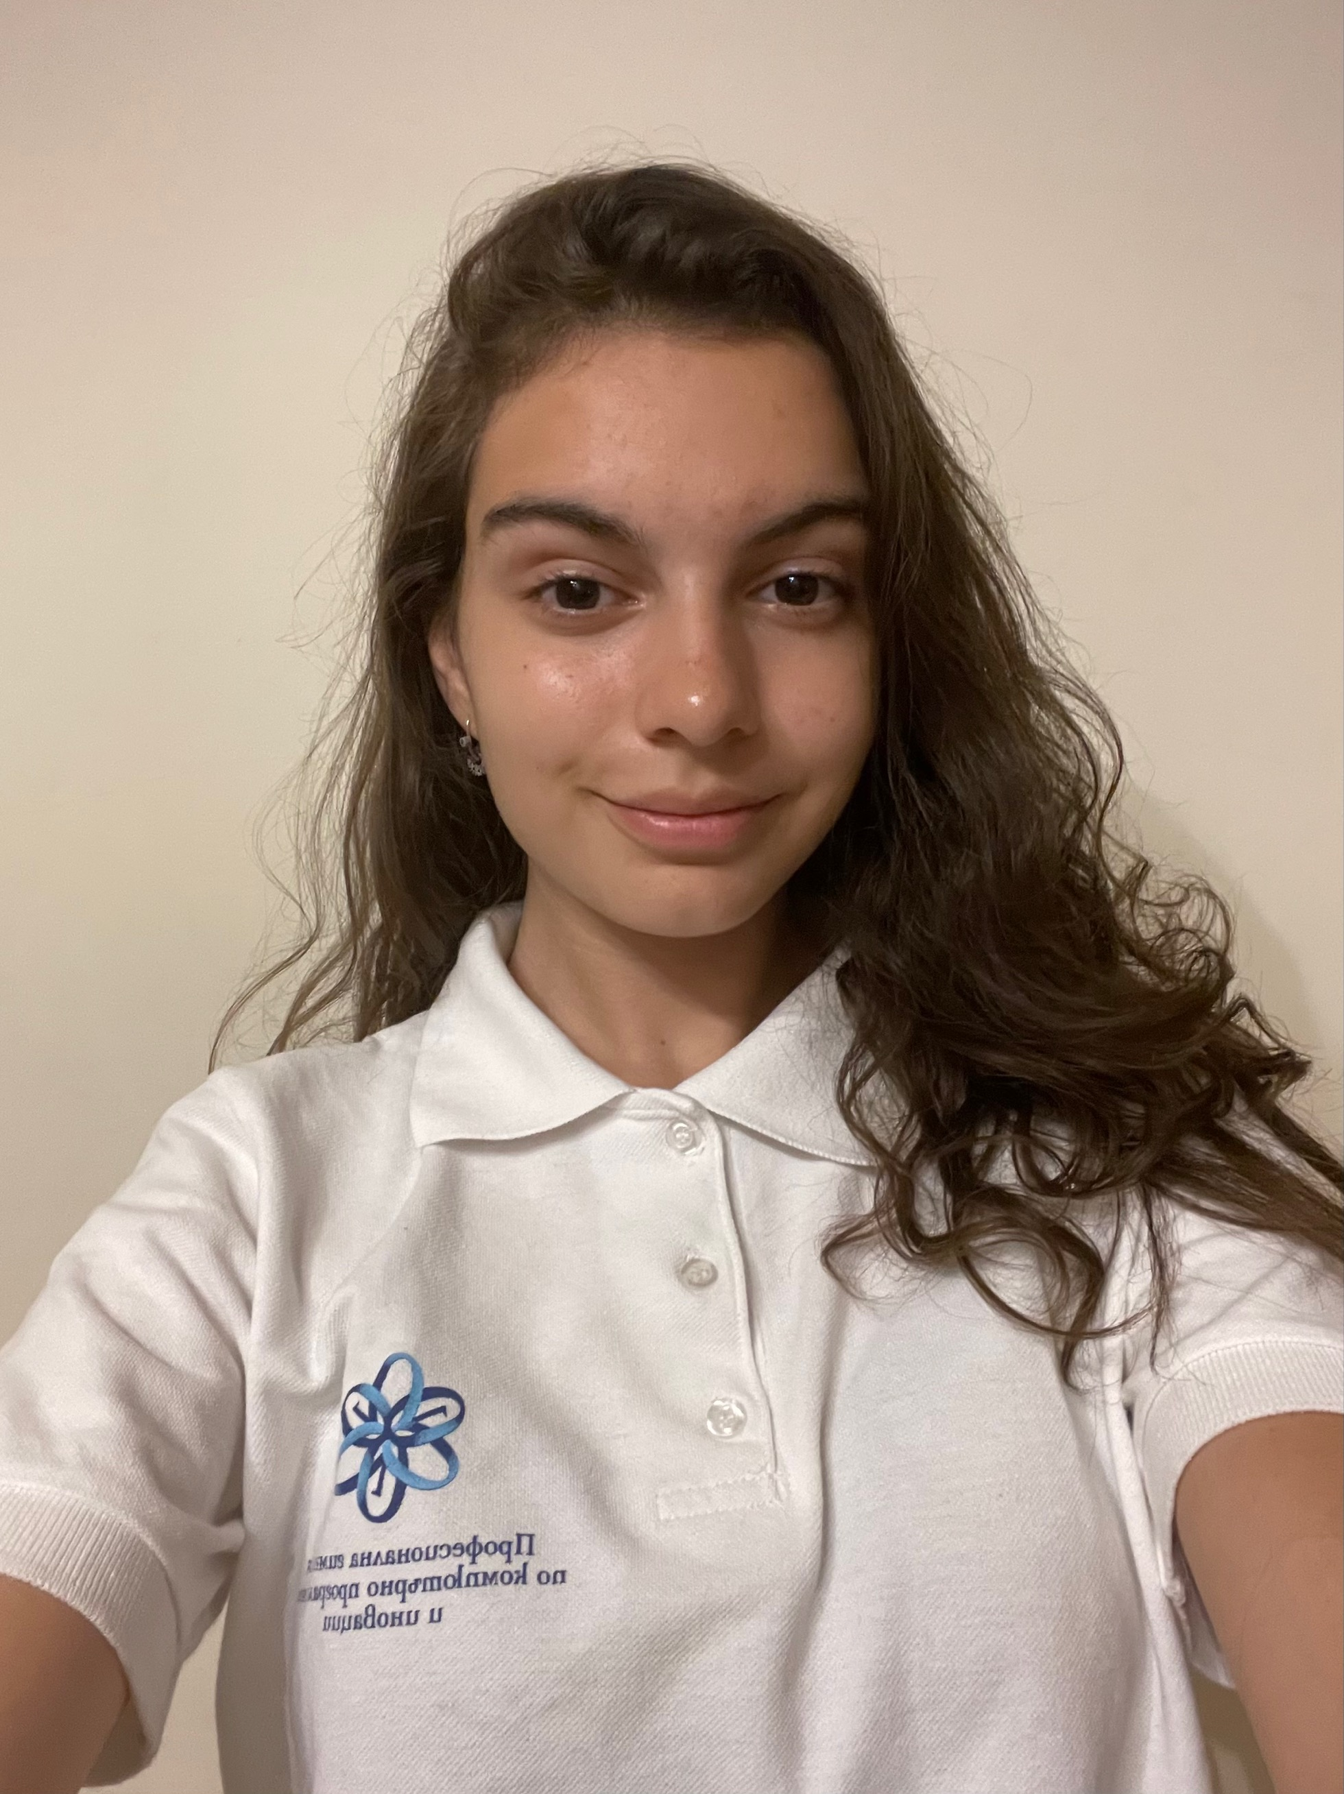
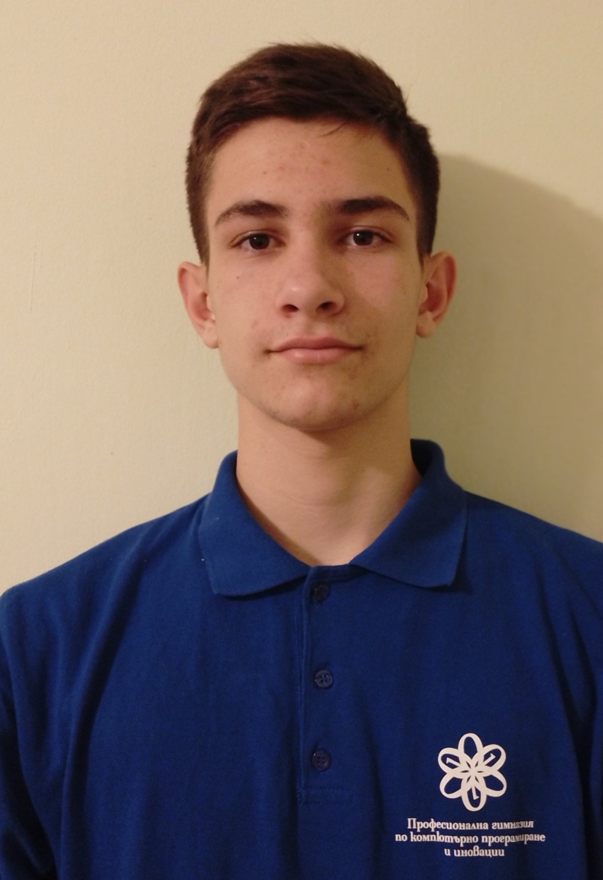
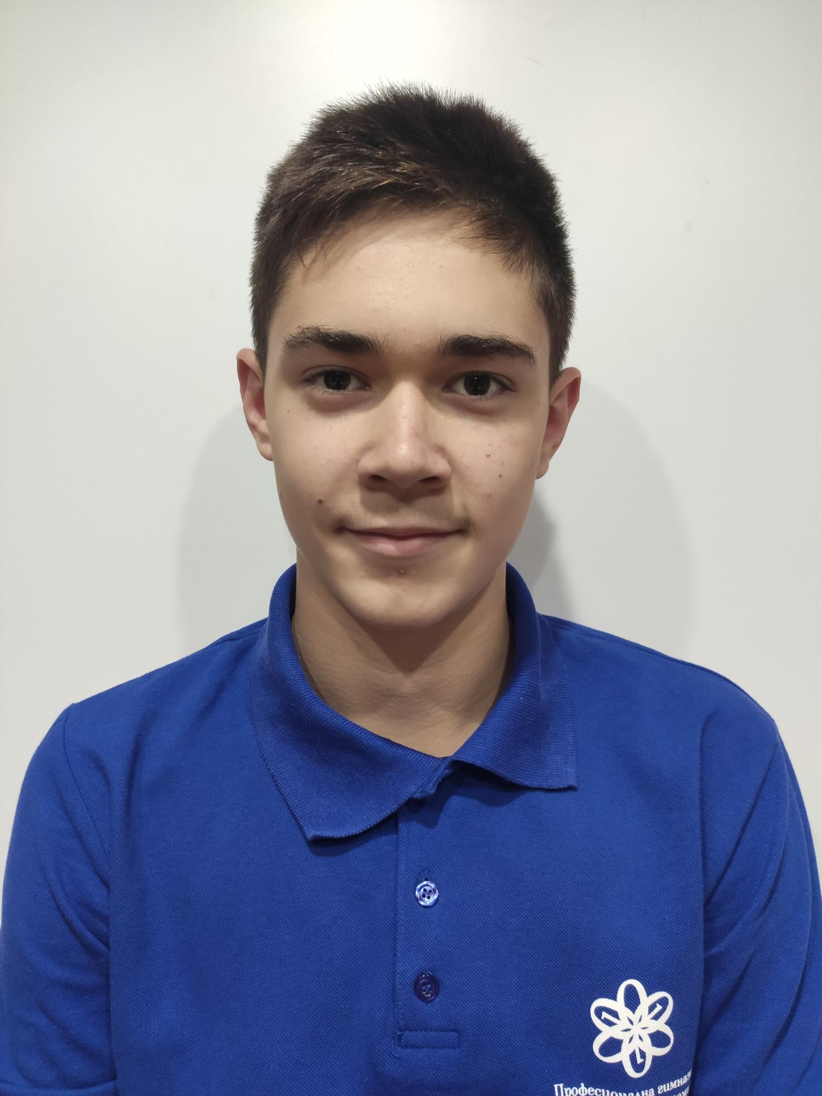
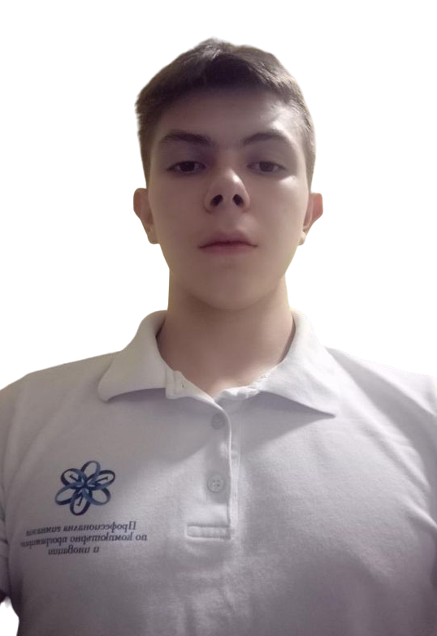
Our team
Kristina Zheleva
(Scrum trainer)
Lazar Apostolov
(Frontend developer)
Svetoslav Zhelev
(Backend developer)
Dimitar Georgiev
(QA)

Slide 3

Work stages
1
2
3
4
Form a team and divide the roles
Choose the idea and start the project
Finish the code and create documentation, presentation and QA
Prepare for presenting the project

Slide 4







Used programs and languages

Slide 5

Enough Talking! Now let’s get to the game…

